Slide 1
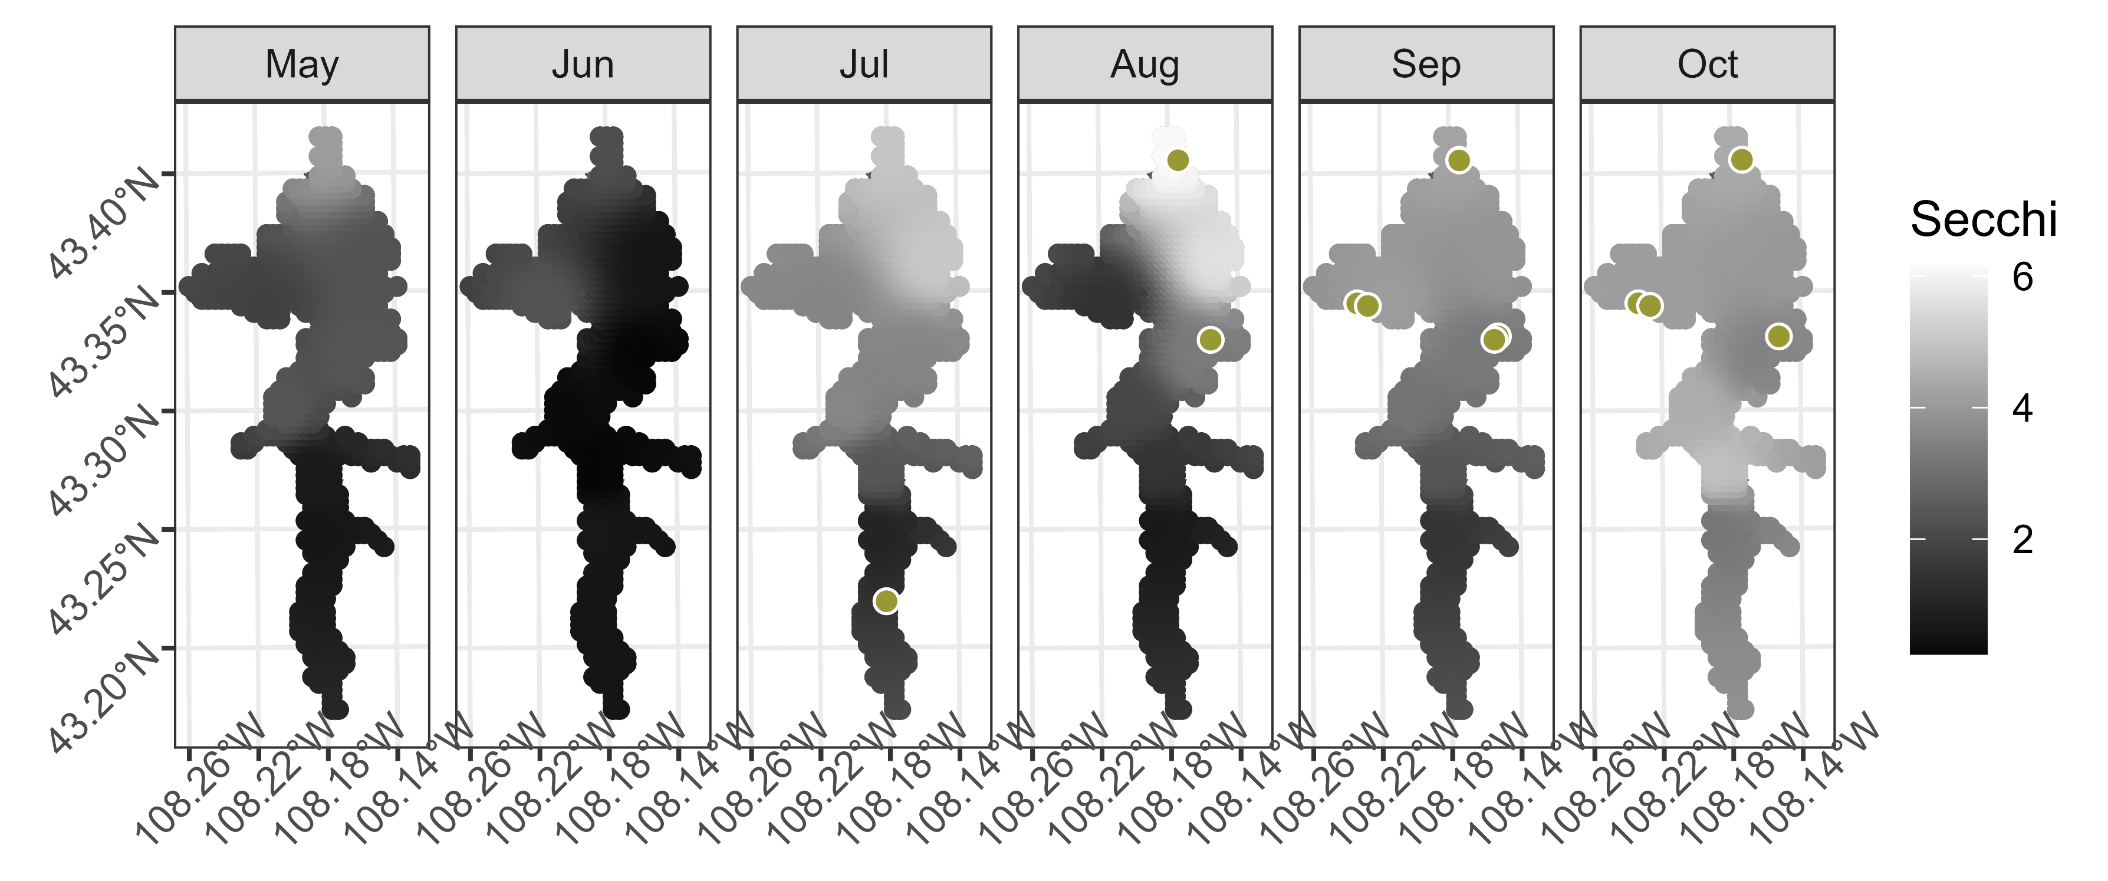
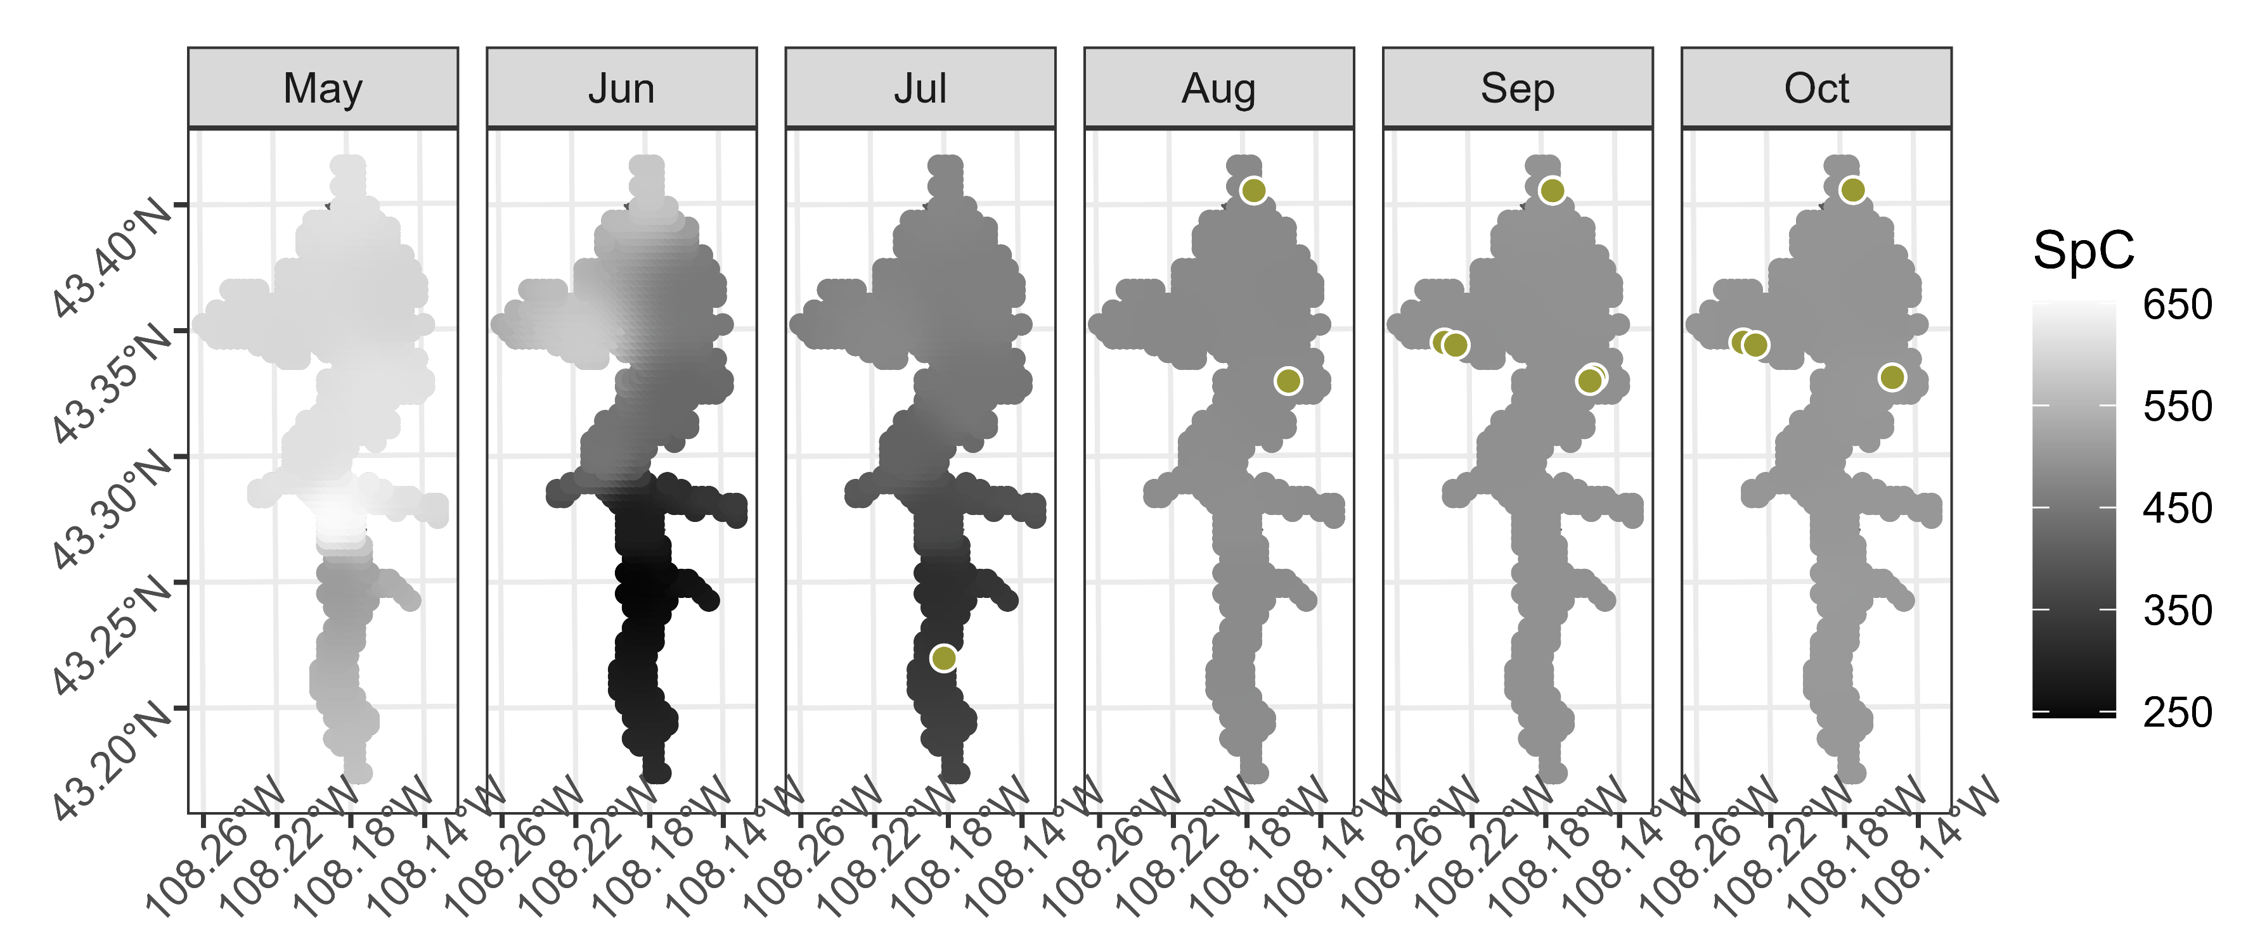
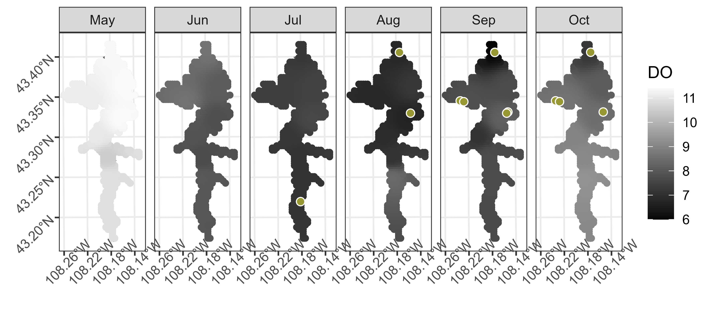
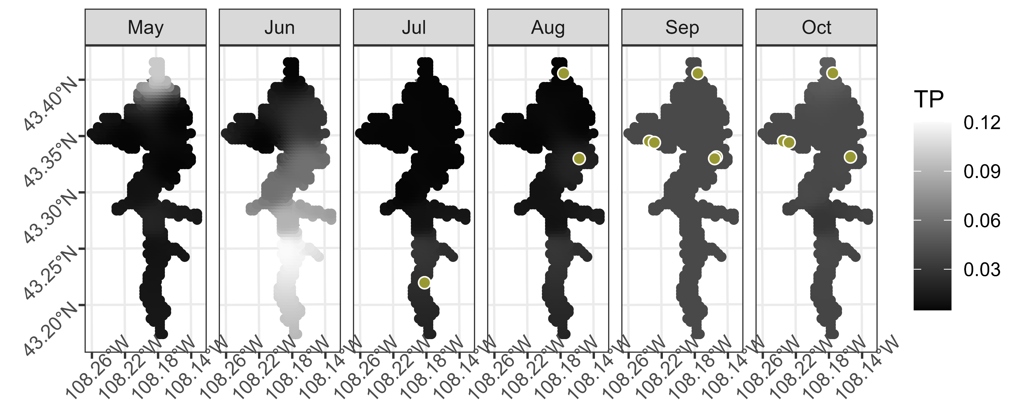
Secchi depth
m
Specific conductivity
µS cm ⁻¹
Dissolved oxygen
mg L⁻¹
Total phosphorus
mg L⁻¹

